Slide 1
Adversarial Search
Md Mehrab Hossain Opi
CSE 4109: Artificial Intelligence

Slide 2
Adversarial Search
Adversarial Search refers to a type of search algorithm used in multi-agent environments, where agents (players) compete against each other.
Unlike simple search algorithms that assume a single agent optimizing for one goal, adversarial search considers an opponent who tries to hinder the agent’s success.

Slide 3
Tic-Tac-Toe Game
🎮 Tic-Tac-Toe Rules
Players:
Two players: X and O
X always goes first
Board:
A 3 × 3 grid
Turns:
Players alternate placing their mark (X or O) on an empty square.
Winning Condition:
First player to get 3 in a row (horizontal, vertical, or diagonal) wins.
Draw Condition:
If all 9 squares are filled and no winner, the game ends in a draw.
X | X | O
O | X
O |  | X

Slide 4
Tic-Tac-Toe Game
Now consider two agents playing Tic-Tac-Toe.
Both are trying to win the game.
How does one agent decide its next move?
In traditional search, we only thought about finding a path or solution.
But in games, the other player is also making moves to stop us.
So, we must anticipate the opponent’s actions when deciding.
This need to plan against an opponent leads to Adversarial Search.
X | X | O
O | X
O |  | X

Slide 5
Tic-Tac-Toe Game
Computer doesn’t understand the notion of winning or losing.
It only understands numeric value.
Concept of bigger and smaller.
So, what we will try to do is give each possible outcome a number.
How many outcomes are possible?
X | X | O
O | X
O |  | X

Slide 6
Tic-Tac-Toe Game
O | X | X
O | O
O | X | X
X | X | O
O | X | X
X | O | O
X | X | O
O | X
O |  | X
-1
0
1

Slide 7
Tic-Tac-Toe Game
Player X always try to get maximum score possible.
Win = 1.
If can’t win draw = 0.
Player O always try to get the minimum score possible.
Win = -1, draw = 0.
O | X | X
O | O
O | X | X
X | X | O
O | X | X
X | O | O
X | X | O
O | X
O |  | X
-1
0
1

Slide 8
Tic-Tac-Toe Game
We will call X the MAX player.
And O will be called the MIN player.
O | X | X
O | O
O | X | X
X | X | O
O | X | X
X | O | O
X | X | O
O | X
O |  | X
-1
0
1

Slide 9
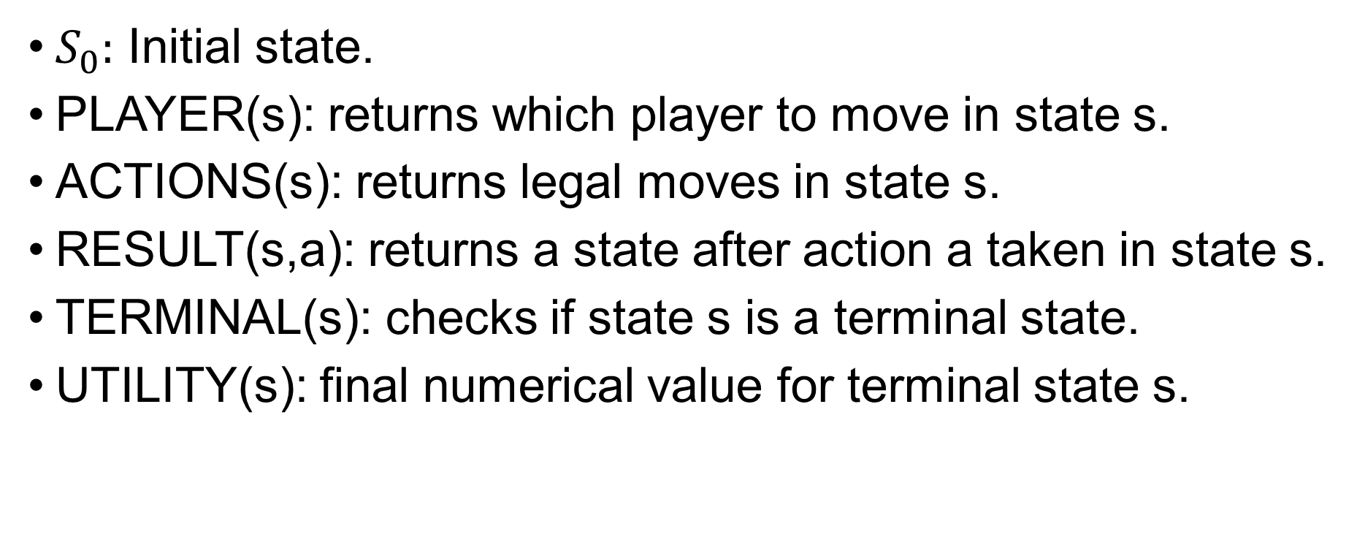
Game Definition
$S_{0}:$ Initial state.
PLAYER(s): returns which player to move in state s.
ACTIONS(s): returns legal moves in state s.
RESULT(s,a): returns a state after action a taken in state s.
TERMINAL(s): checks if state s is a terminal state.
UTILITY(s): final numerical value for terminal state s.

Slide 10
Initial State

Slide 11
PLAYER(s)
PLAYER( ) = X
PLAYER( ) = O
 | X

Slide 12
ACTIONS(s)
ACTIONS( ) = { , }
 | X | O
O | X | X
X |  | O
O
 | O

Slide 13
RESULTS(s, a)
RESULT( , ) =
 | X | O
O | X | X
X |  | O
O | X | O
O | X | X
X |  | O
O

Slide 14
TERMINAL(s)
TERMINAL( ) = false
TERMINAL( ) = true
 | X | O
O | X | X
X |  | O
X | X | O
O | X | X
X | O | O

Slide 15
UTILITY(s)
UTILITY( ) = -1
UTILITY( ) = 1
O | X | X
O | O
O | X | X
X | X | O
O | X
O |  | X

Slide 16
UTILITY(s)
UTLITY( ) = ?
 | X | O
O | X | X
X |  | O
This is where the Minimax algorithm comes in.

Slide 17
UTILITY(s)
 | X | O
O | X | X
X |  | O
PLAYER(s) = O
Min-Value: 0
O | X | O
O | X | X
X |  | O
 | X | O
O | X | X
X | O | O
PLAYER(s) = X
Max-Value: 0
Max-Value: 1
O | X | O
O | X | X
X | X | O
X | X | O
O | X | X
X | O | O
Value: 1
Value: 0

Slide 18
UTILITY(s)
 | X | O
O | X
X |  | O
 | X | O
O | X | X
X |  | O
X | X | O
O | X
X |  | O
 | X | O
O | X
X | X | O
O | X | O
O | X | X
X |  | O
 | X | O
O | X | X
X | O | O
X | X | O
O | X | O
X |  | O
X | X | O
O | X
X | O | O
O | X | O
O | X | X
X | X | O
X | X | O
O | X | X
X | O | O
X | X | O
O | X | X
X | O | O

Slide 19
Minimax Algorithm
function MAX-VALUE(state) returns a utility value
if TERMINAL-TEST(state) then
return UTILITY(state)
v ←−∞
for each a in ACTIONS(state) do
v ←MAX(v,MIN-VALUE(RESULT(s, a)))
return v

Slide 20
Minimax Algorithm
function MIN-VALUE(state) returns a utility value
if TERMINAL-TEST(state) then
return UTILITY(state)
v ←∞
for each a in ACTIONS(state) do
v ←MIN(v,MAX-VALUE(RESULT(s, a)))
return v

Slide 21
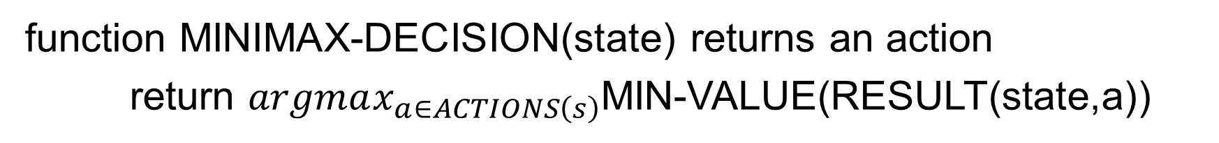
Minimax Algorithm
function MINIMAX-DECISION(state) returns an action
return $argmax_{a∈ACTIONS\left(s\right)}$MIN-VALUE(RESULT(state,a))
Assuming the player wants to minimize the utility value.

Slide 22
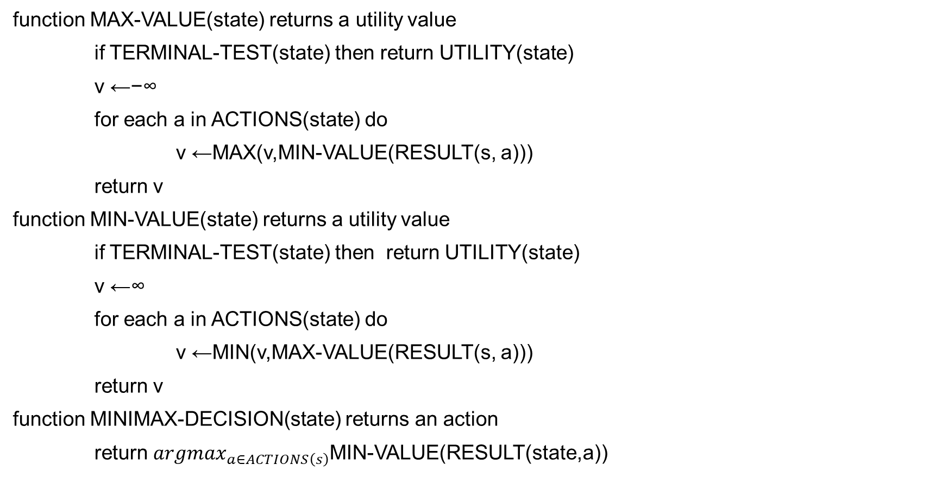
Minimax Algorithm
function MAX-VALUE(state) returns a utility value
if TERMINAL-TEST(state) then return UTILITY(state)
v ←−∞
for each a in ACTIONS(state) do
v ←MAX(v,MIN-VALUE(RESULT(s, a)))
return v
function MIN-VALUE(state) returns a utility value
if TERMINAL-TEST(state) then return UTILITY(state)
v ←∞
for each a in ACTIONS(state) do
v ←MIN(v,MAX-VALUE(RESULT(s, a)))
return v
function MINIMAX-DECISION(state) returns an action
return $argmax_{a∈ACTIONS\left(s\right)}$MIN-VALUE(RESULT(state,a))

Slide 23
Thank You.

